Slide 1
Charm quarks production from pre-equilibrium
10/11/2023
DPHN-IRFU-CEA
Faure Thomas

Slide 2
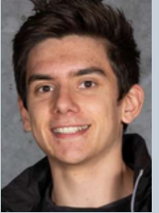


Who am I?
Thomas Faure
Engineering student (equivalent to master student) at CentraleSupélec
Gap year : first internship with Michael Winn at the IRFU at CEA Paris-Saclay
Study of the production of charm quarks during pre-equilibrium

Slide 3
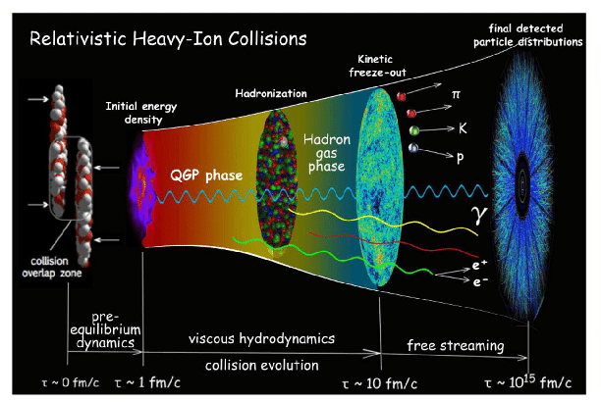
Quick reminder
Formation of the quark-gluon plasma
little bang © C. Shen&P. Sorensen

Slide 4
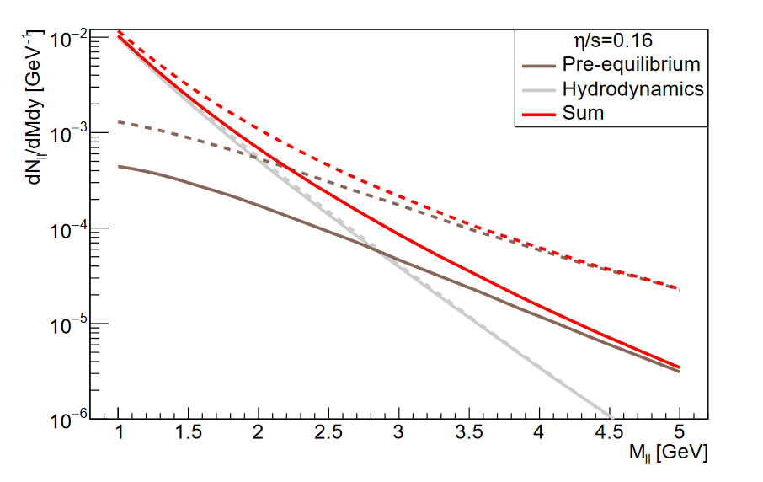
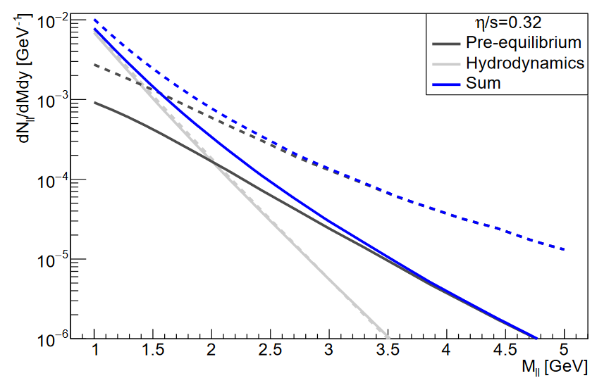
What prompted this topic?
The Intermediate mass dileptons as pre-equilibrium probes in heavy ion collisions study
 | arXiv:2104.07622
Study driven by Maurice Coquet, Xiaojian Du, Jean-Yves Ollitrault, Sören Schlichting and Michael Winn
Dilepton production yields dNll/dM dY in the 0 − 5% most central 5.02 TeV Pb+Pb collisions at forward rapidity y = 2. Red (left panel) and blue (right panel) curves show the results including (full lines) and not including (dashed lines) the quark suppression factor, for shear viscosity η/s = 0.16, 0.32 in the left and right panels. We also show separately the contributions (see text) from the pre-equilibrium phase (dark grey) and hydrodynamic phase (light grey).

Slide 5
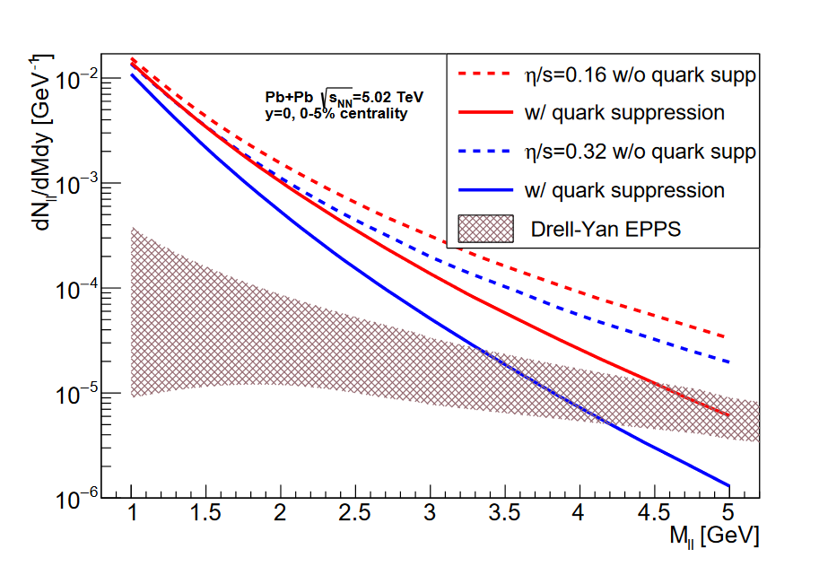
What prompted this topic?
The Intermediate mass dileptons as pre-equilibrium probes in heavy ion collisions study
 | arXiv:2104.07622
Intersection around the mass of the charm/anticharm pair
The production of charm quarks during pre-equilibrium should not be negligible compared with the initial production from hard scatterings.
Dilepton production yields in the 0 − 5% most central 5.02 TeV Pb+Pb collisions at forward rapidity y = 2 for different values of η/s, with and without quark suppression compared with the Drell-Yan rate calculated at NLO with EPPS nuclear PDFs
≈ mass of the charm\anticharm pair

Slide 6
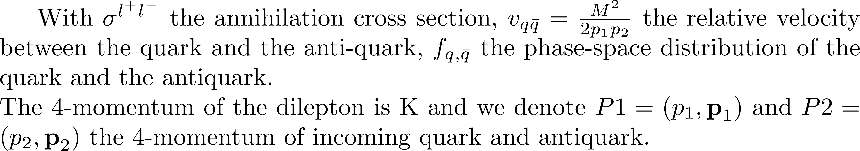
How was the calculation performed?
Production rate

Slide 7
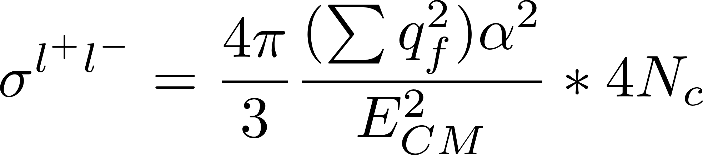
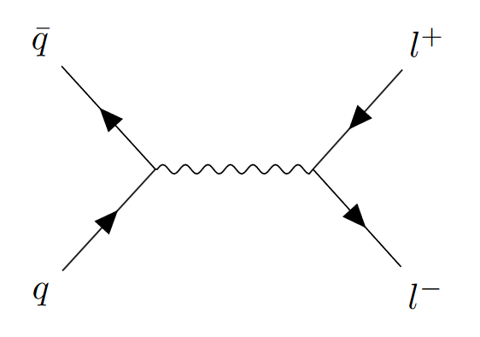
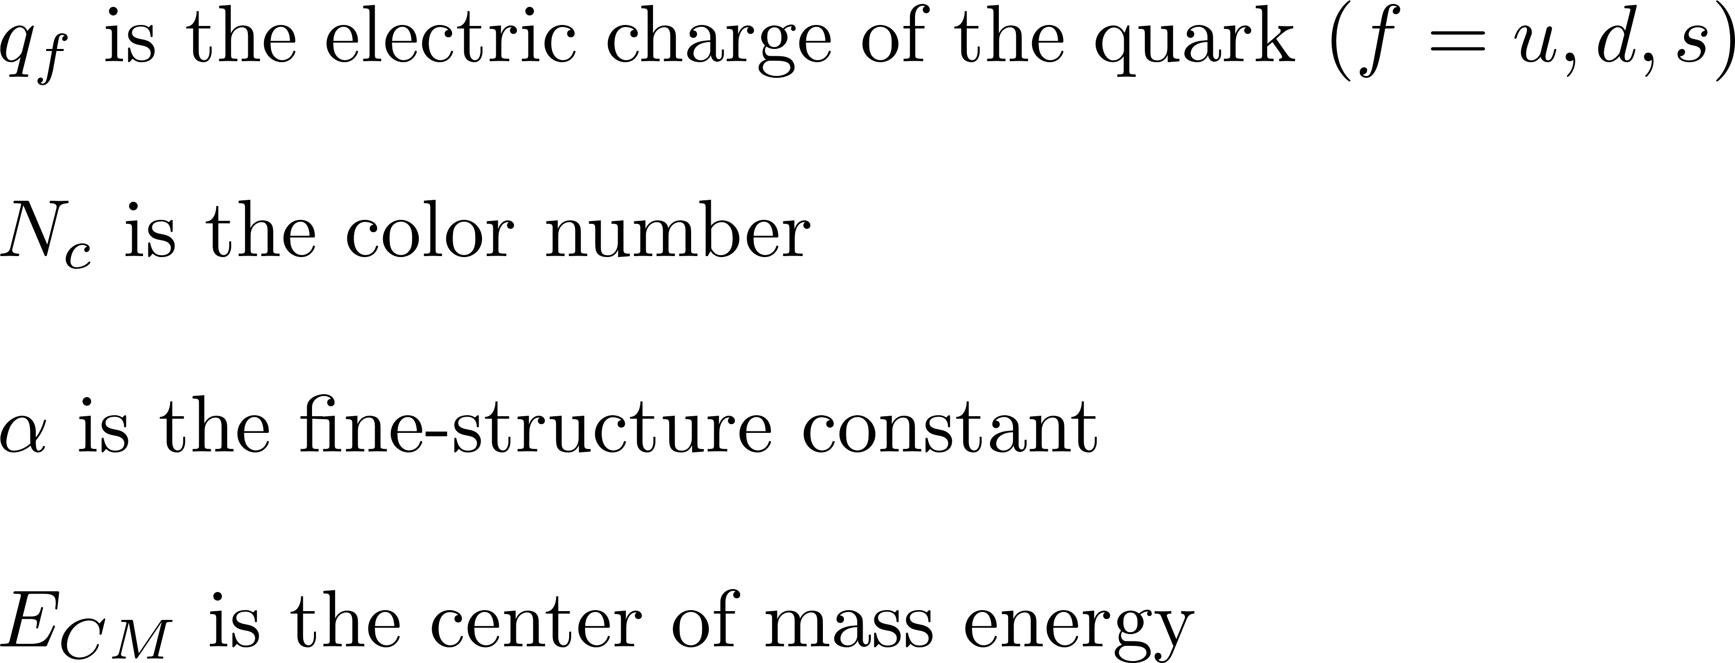
How was the calculation performed?
Cross section

Slide 8
What we changed?
Phase-space distribution
Cross section

Slide 9
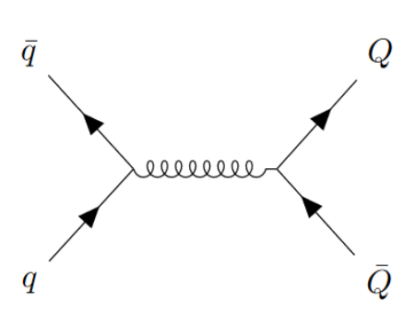
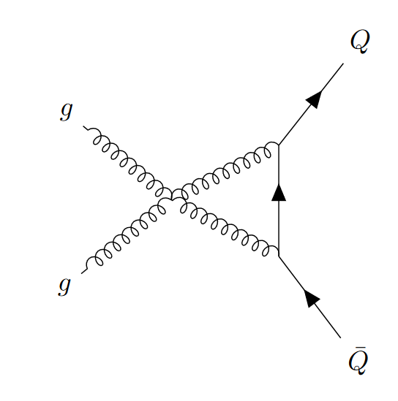
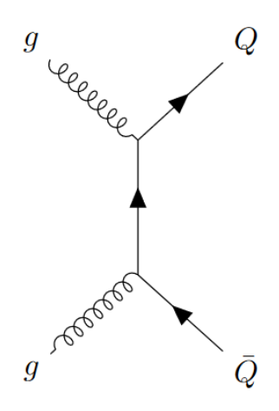
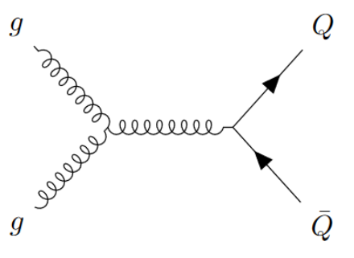
Cross section
Feynman diagram at leading order
Quark antiquark scattering channel
(Photon production negleted)
Gluon scattering channel
s
t
u

Slide 10
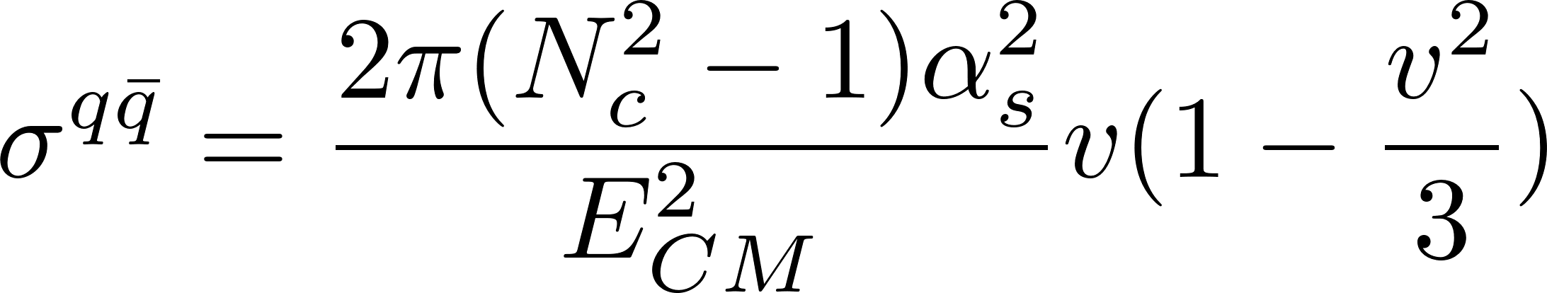
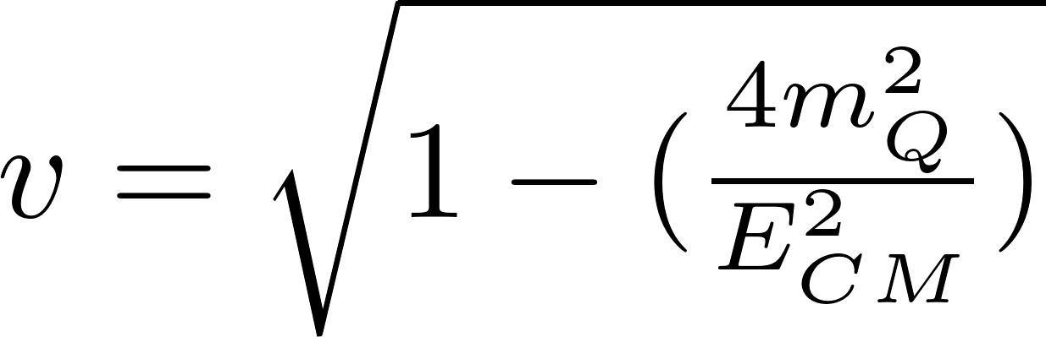
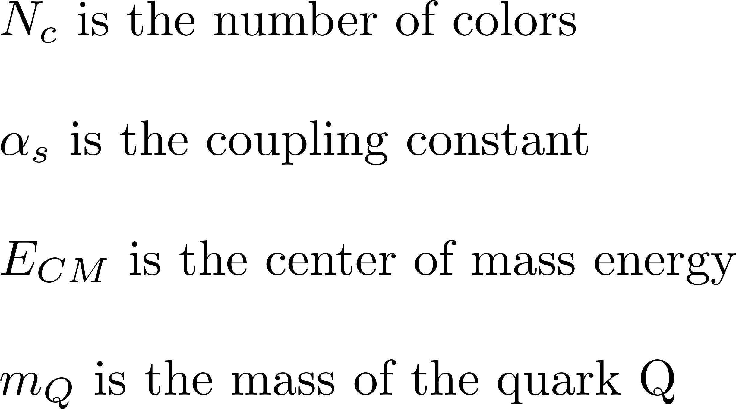
Cross section
Quark antiquark scattering channel

Slide 11
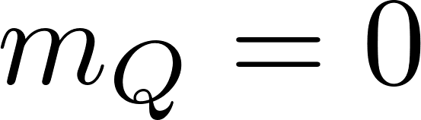
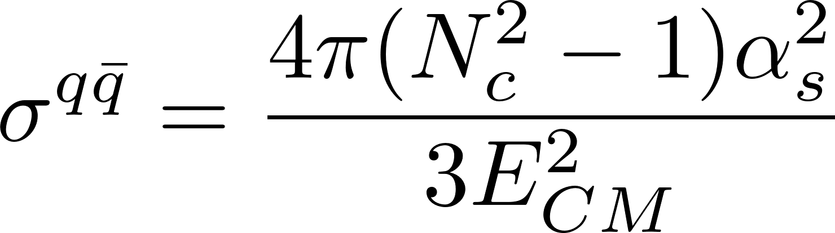
Cross section
Quark channel for massless particles

Slide 12
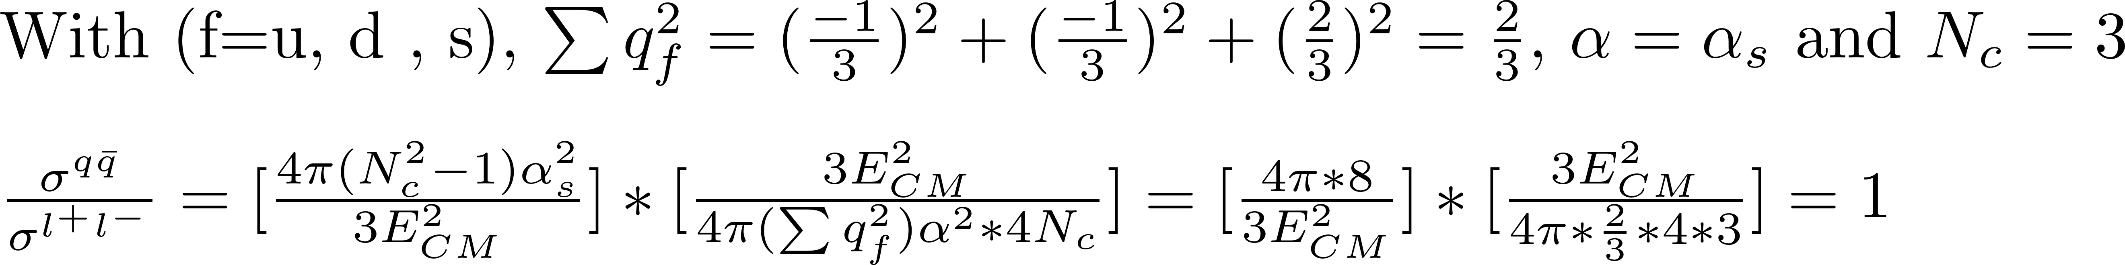
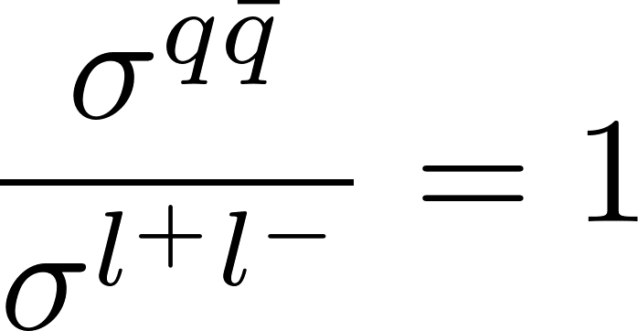
First check
Ration between cross section for α = α_{s} for massless particles

Slide 13
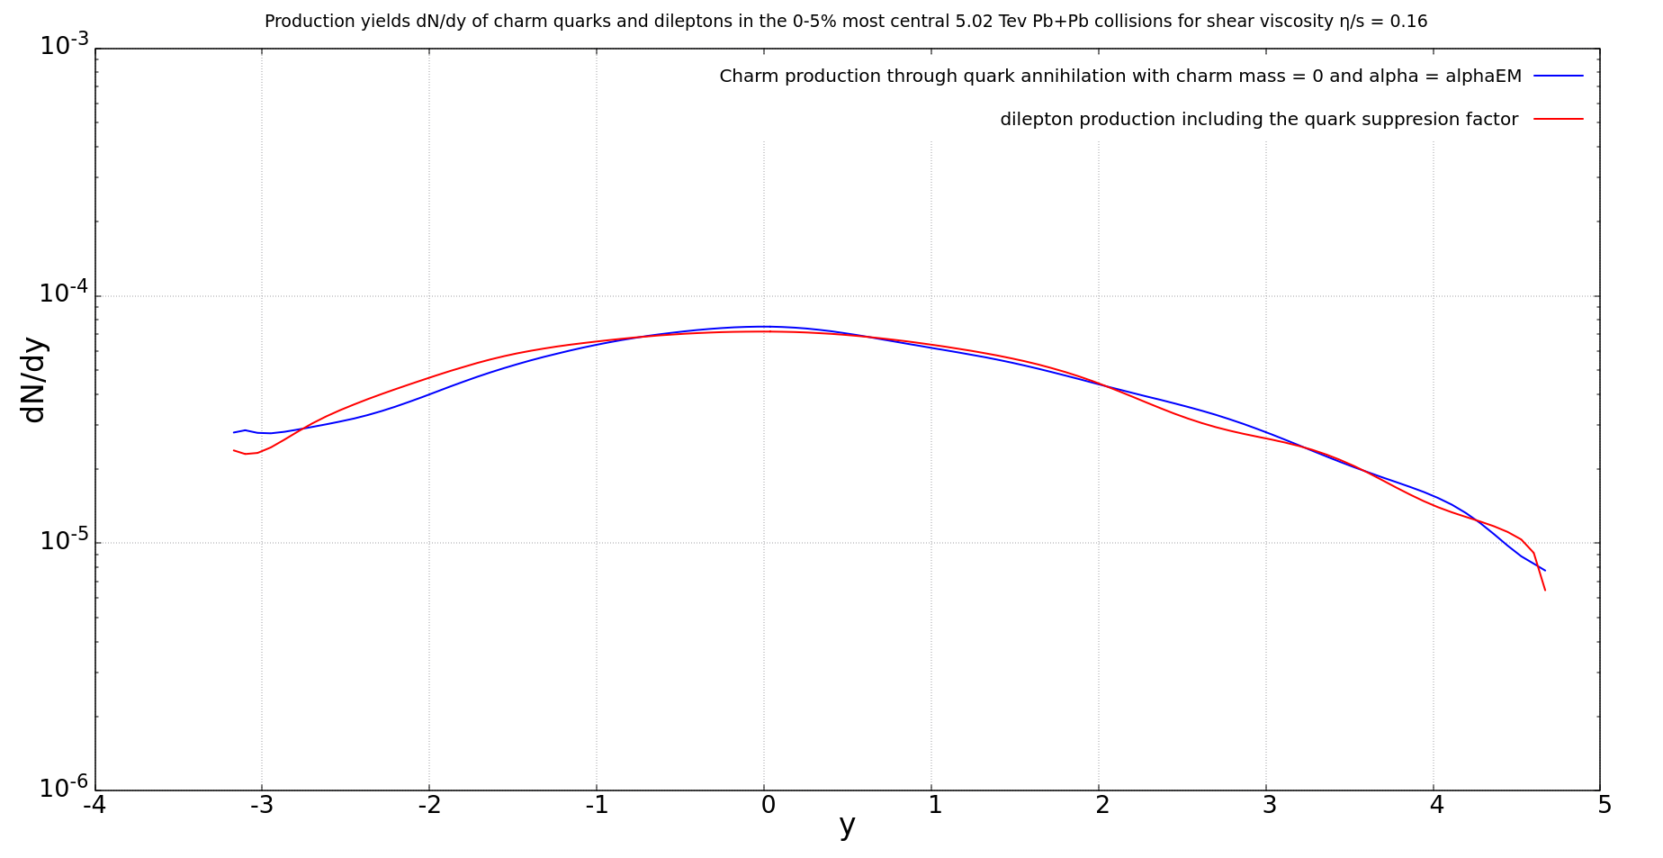
First check
Ration between cross section for α = α_{s} for massless particles

Slide 14
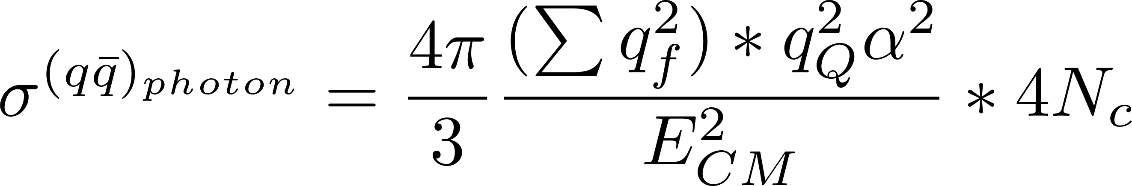
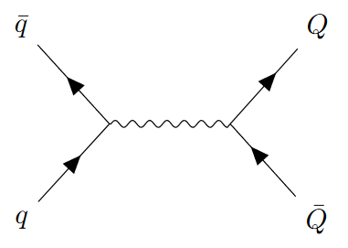
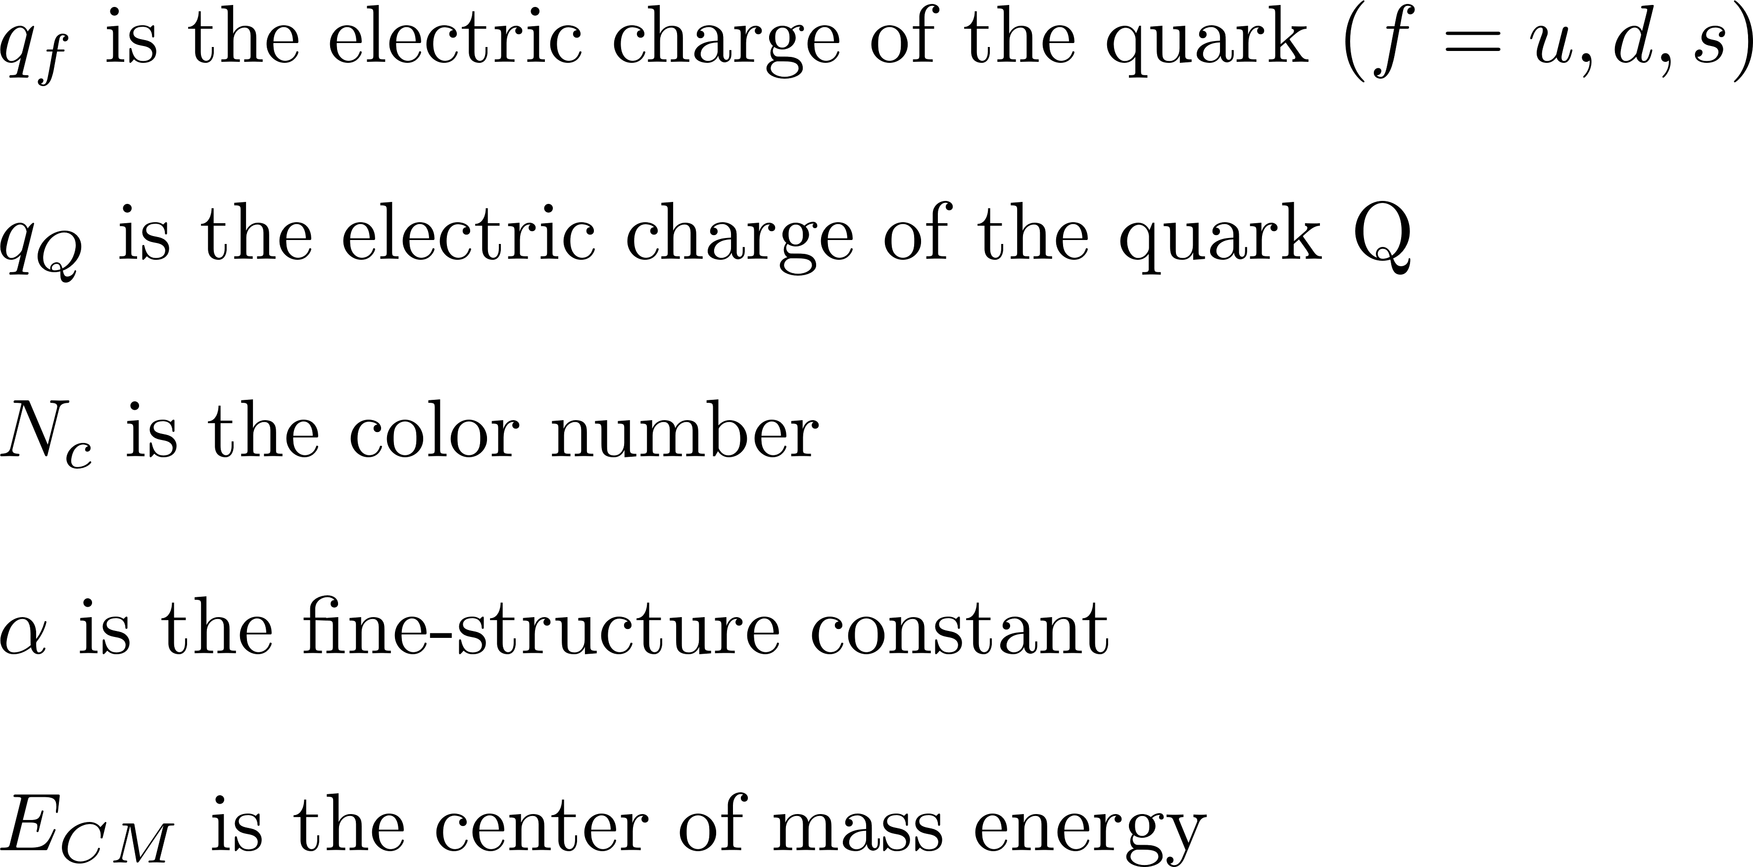
Cross section
Quark channel for massless particles, photon production

Slide 15
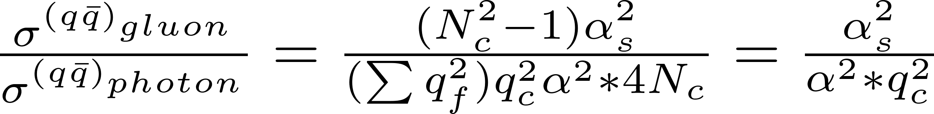
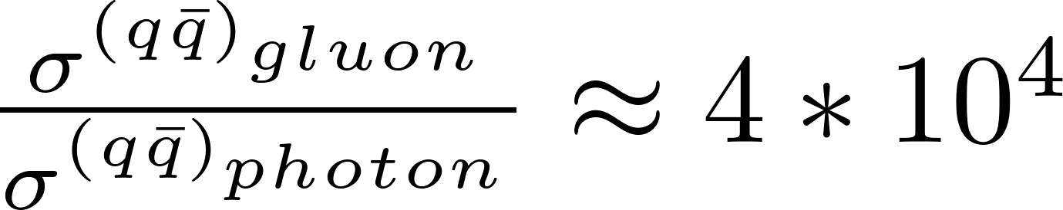
Cross section
Ratio between gluon production and photon production for massless particles
We neglect photon production

Slide 16
Cross section
Gluon scattering channel
s
t
u

Slide 17
Phase-space distribution

Slide 18
Cross section
Gluon channel
Maurice found the same result

Slide 19
Results

Slide 20
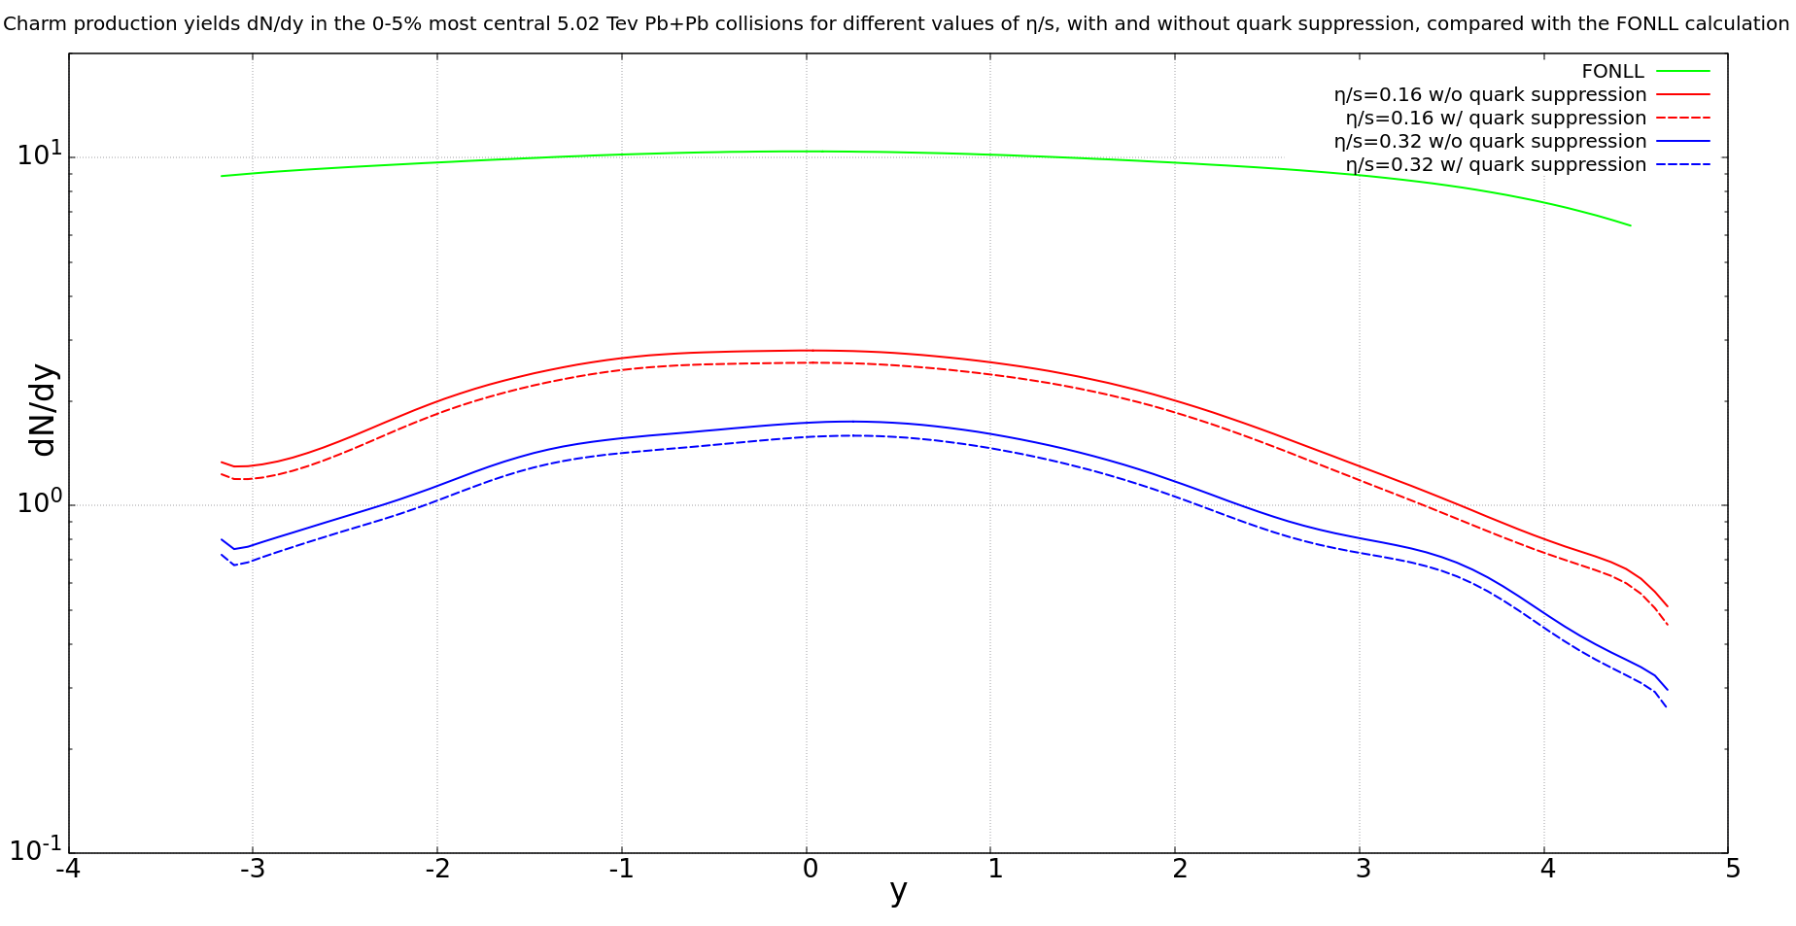
Charm production dN/dy

Slide 21
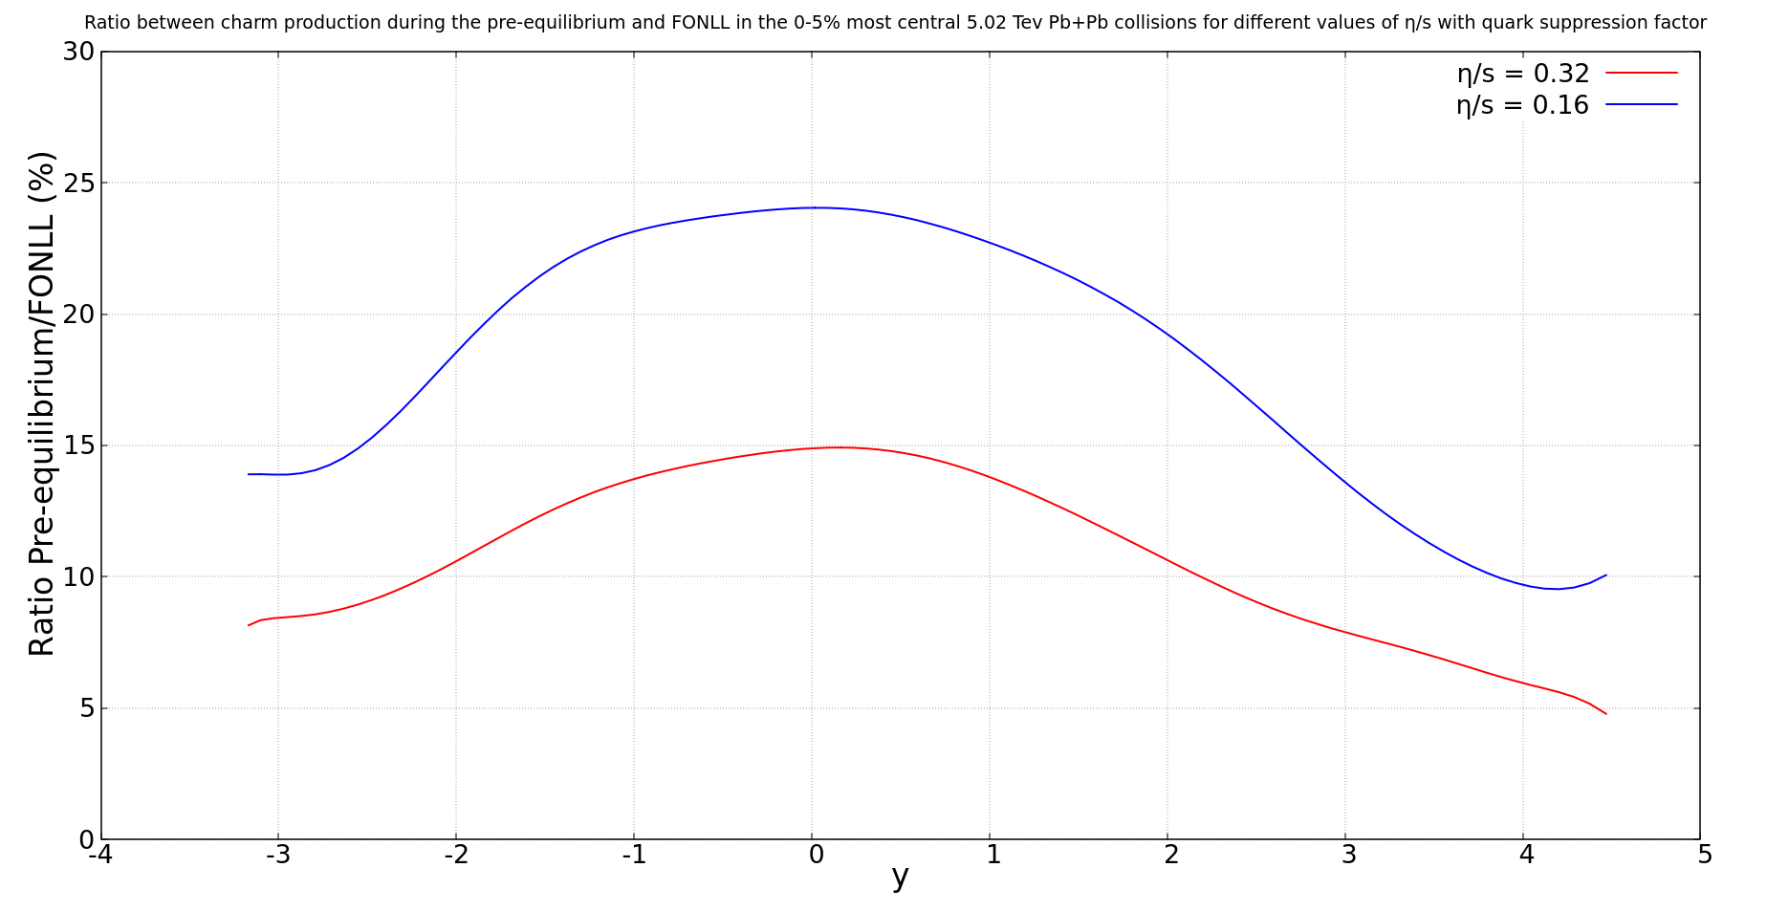
Ratio between charm production and FONLL calculation

Slide 22
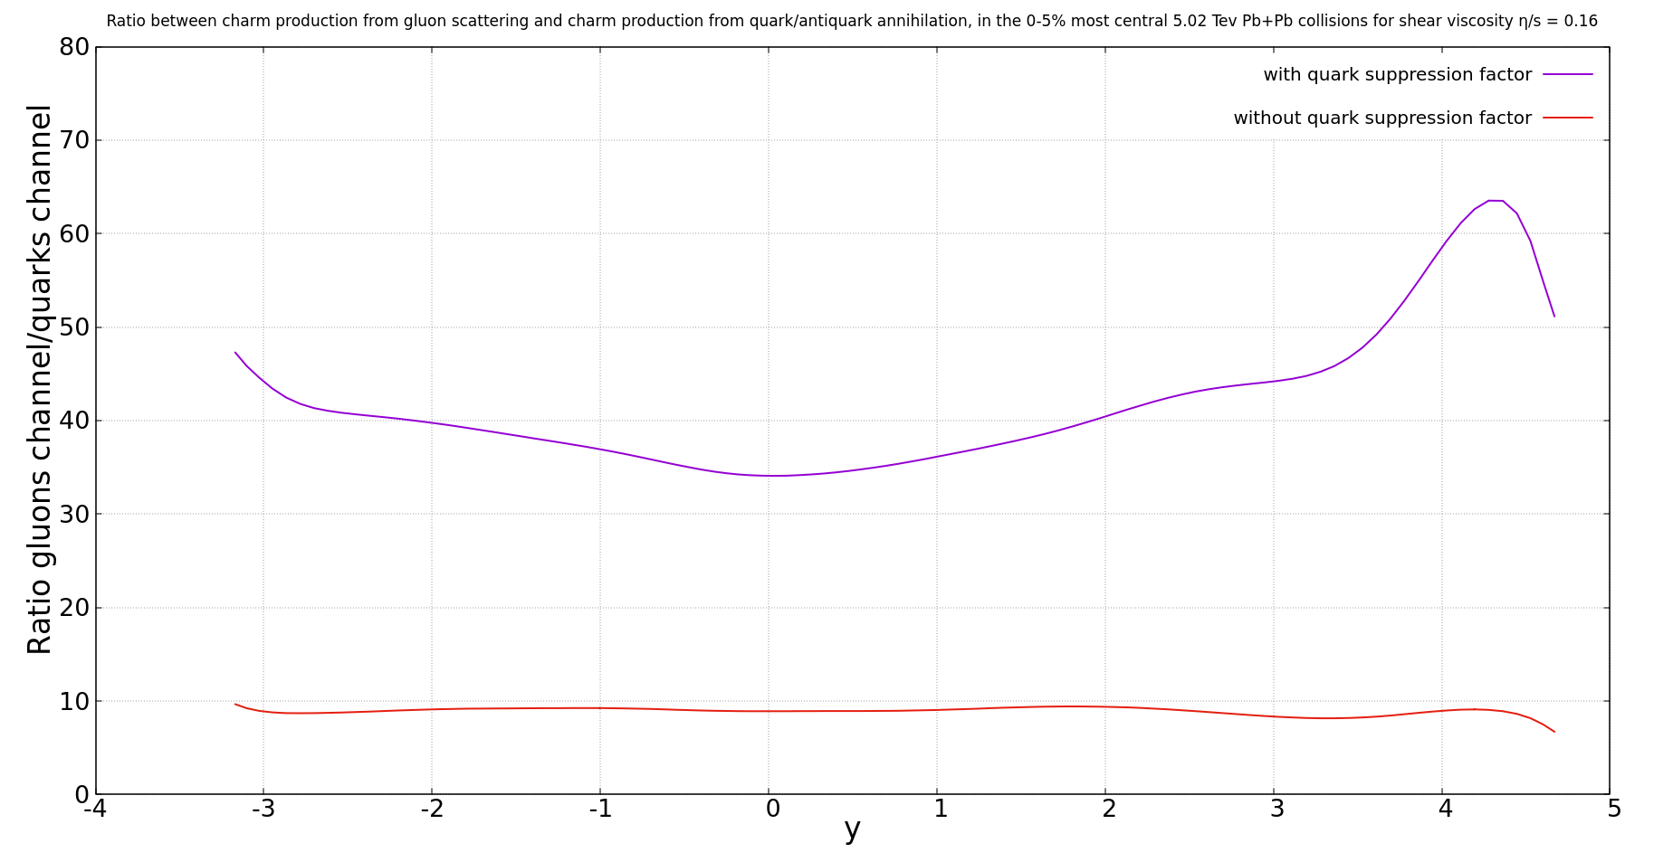
Ratio between charm production from gluon channel and from quark channel

Slide 23
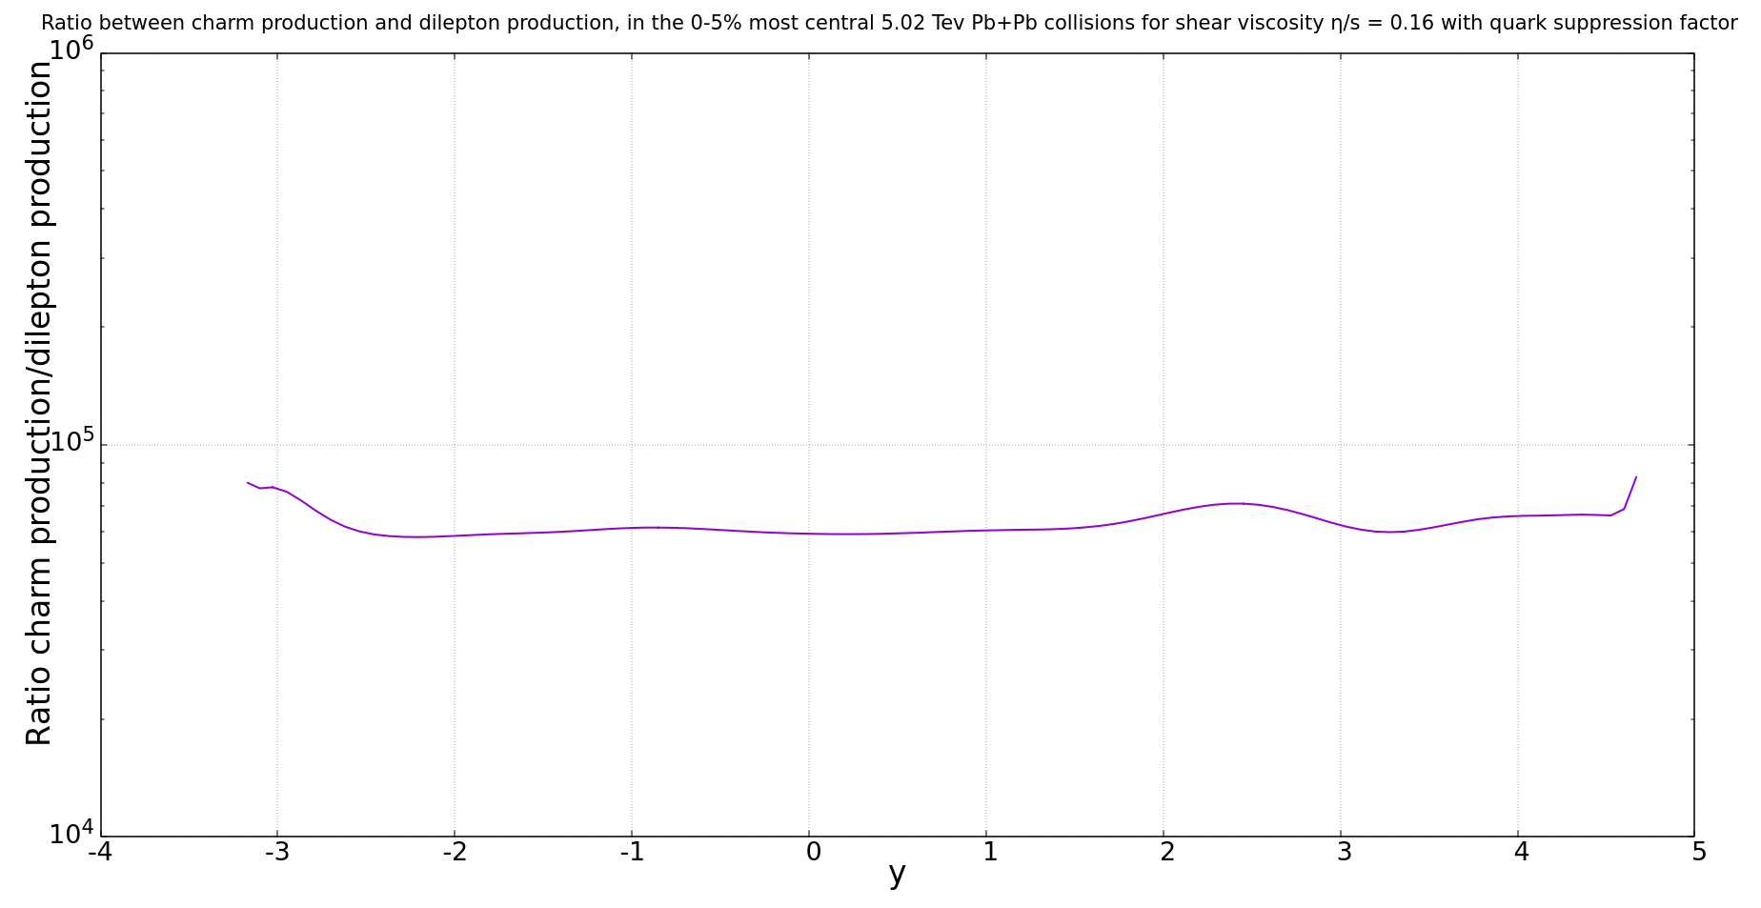
Ratio between charm production and dilepton production

Slide 24
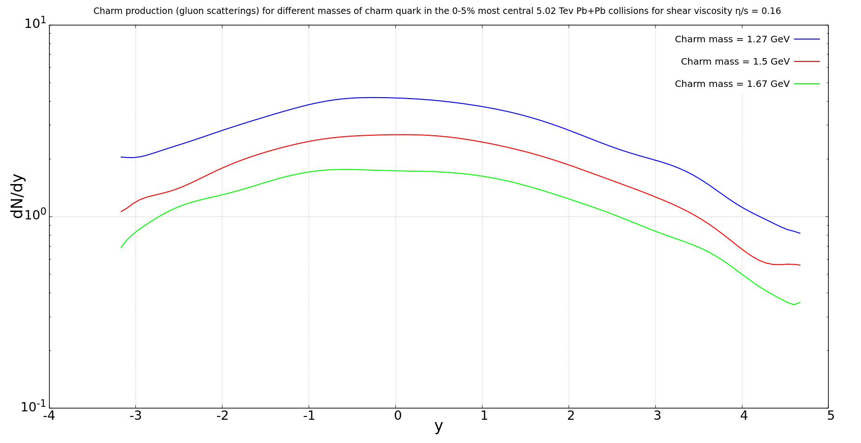
Charm production from gluon channel for different masses

Slide 25
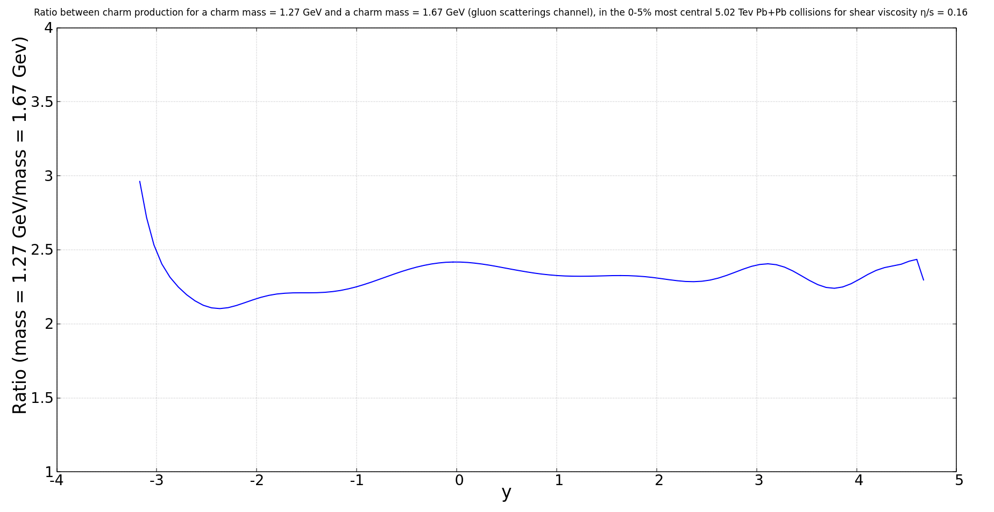
Ratio between charm production for a charm mass = 1.27GeV and a charm mass = 1.67 GeV
Strong sensitivity to charm mass

Slide 26
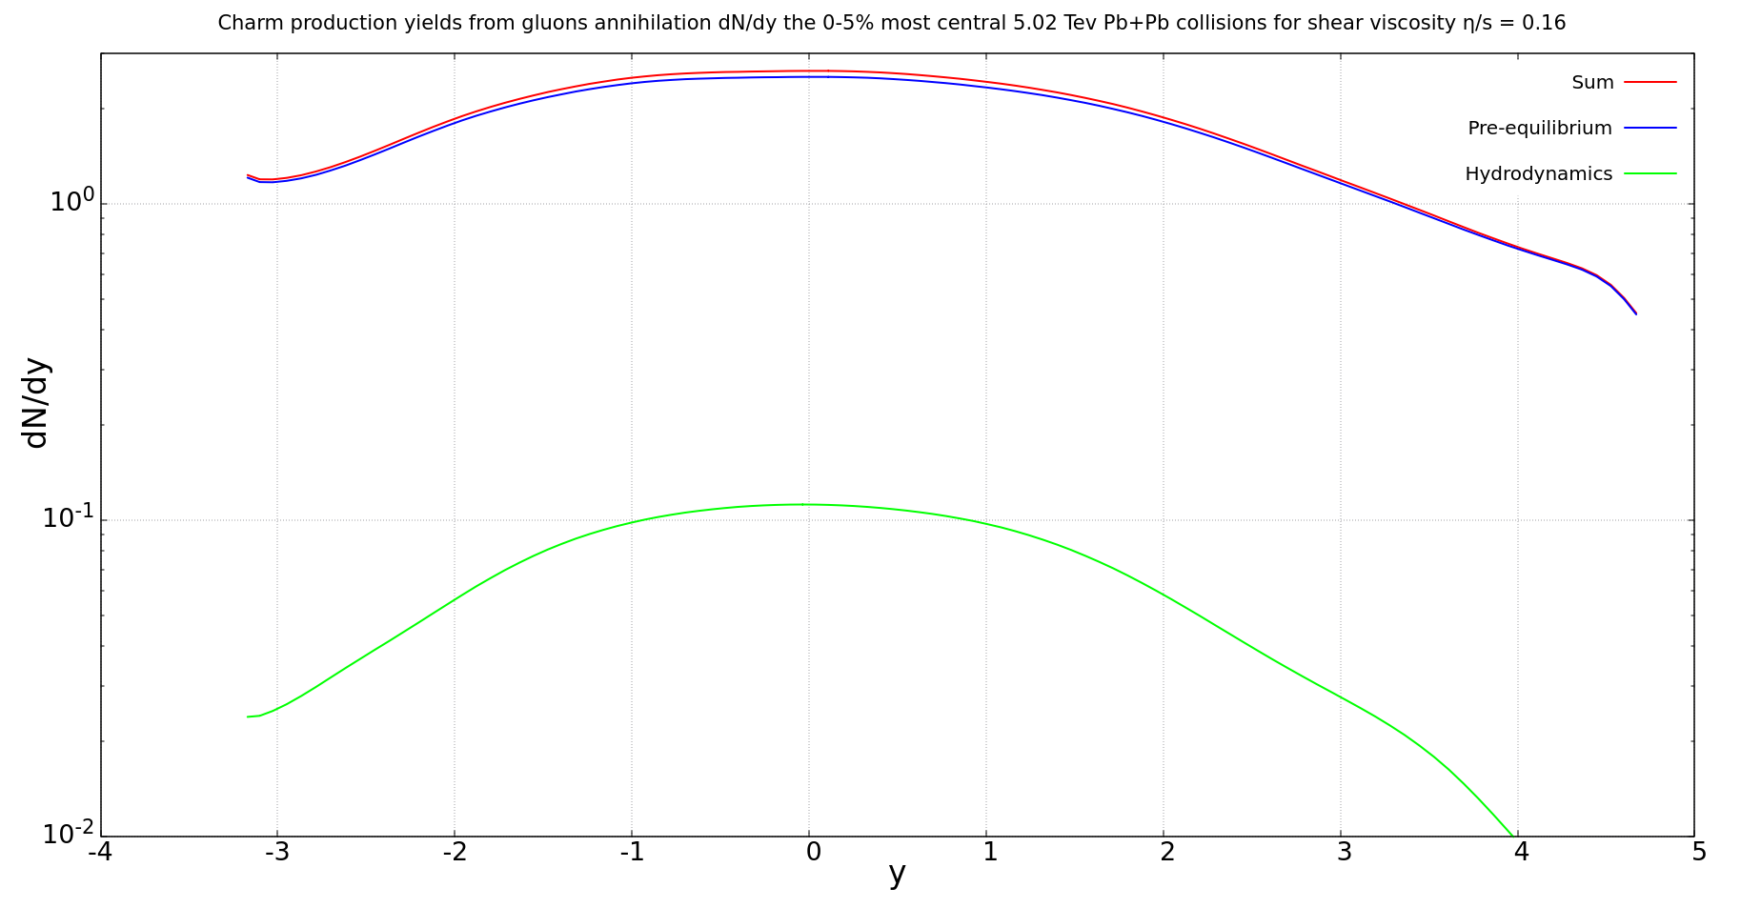
Charm production from gluon channel

Slide 27
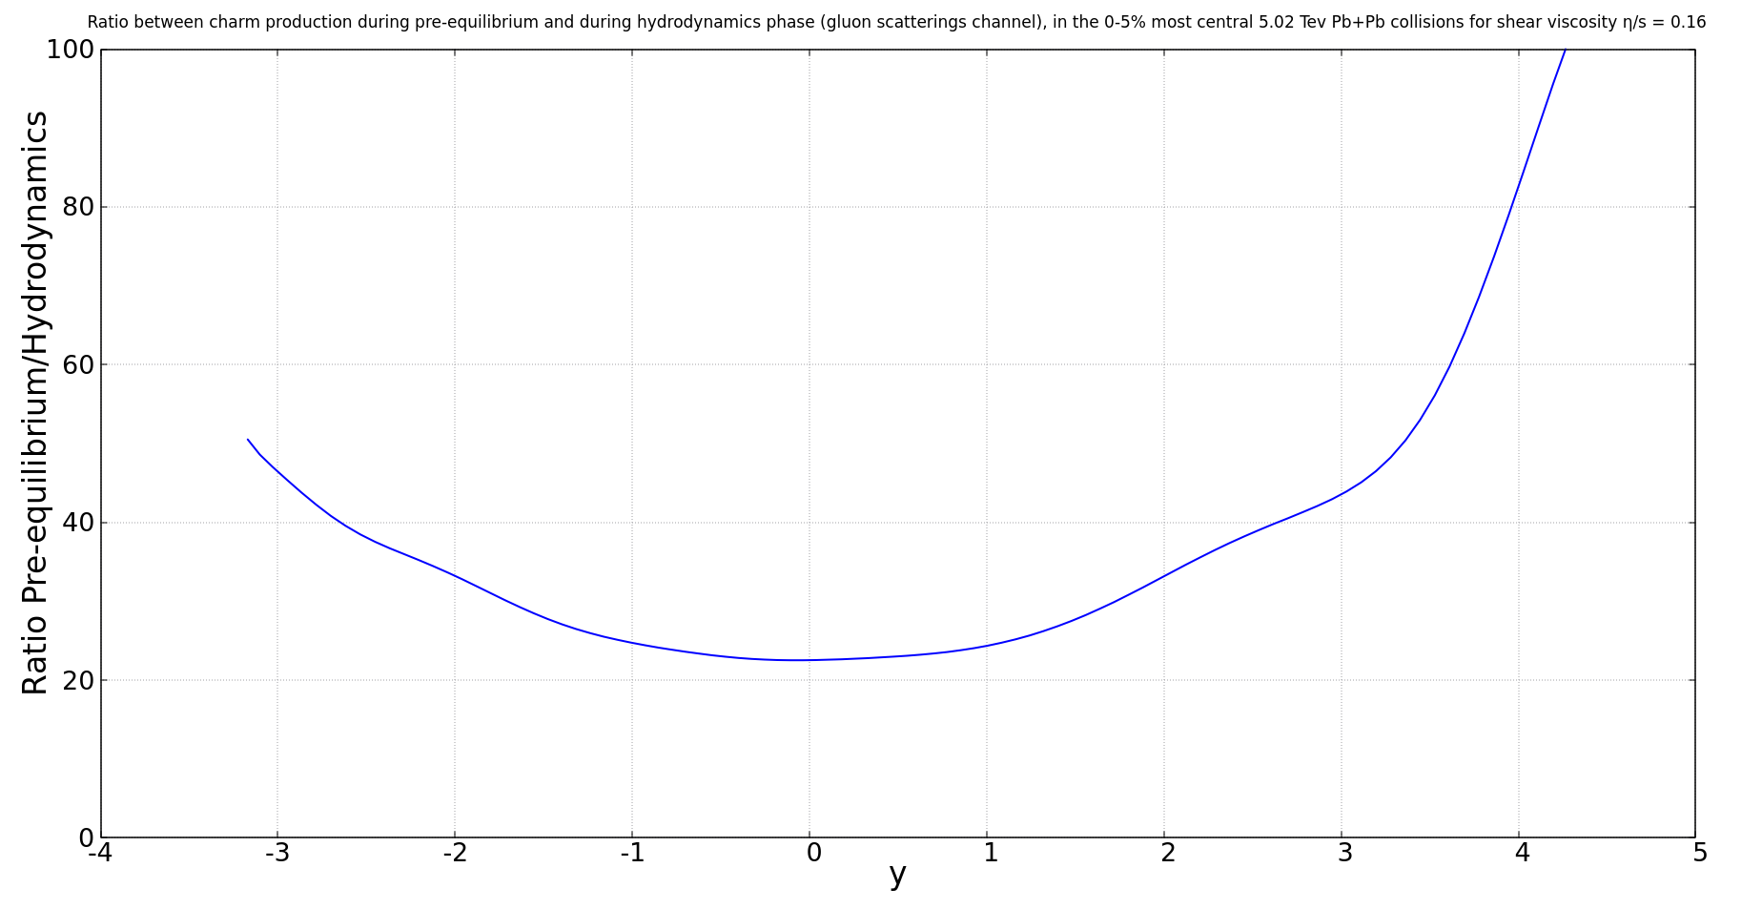
Ratio between pre-equilibrium production and hydrodynamics production

Slide 28
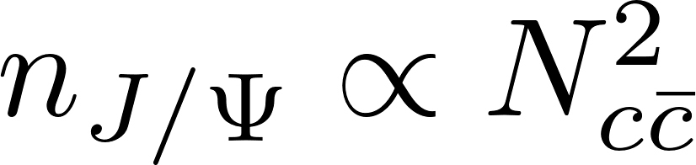
What changes?
Production of J/Ψ that we expect
Statistical Hadronization:

Slide 29
What changes?
Production of J/Ψ that we expect

Slide 30
Conclusion
The production during pre-equilibrium is not negligible compared to hard scatterings (around 20%)
Strong sensitivity to charm mass

Slide 31
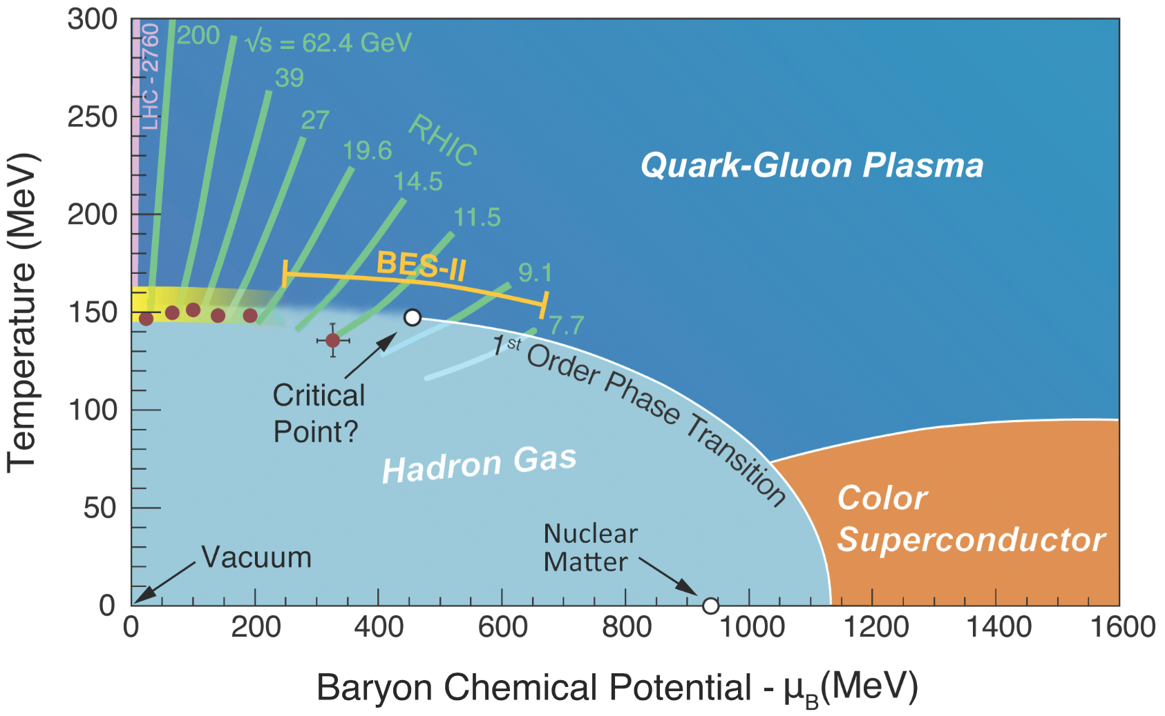
QGP
S. Mukherjee, Quark-matter fireballs hashed out in Protvino, (2012), https://cerncourier.com/a/quark-matter-fireballs-hashed-out-in-protvino/

Slide 32
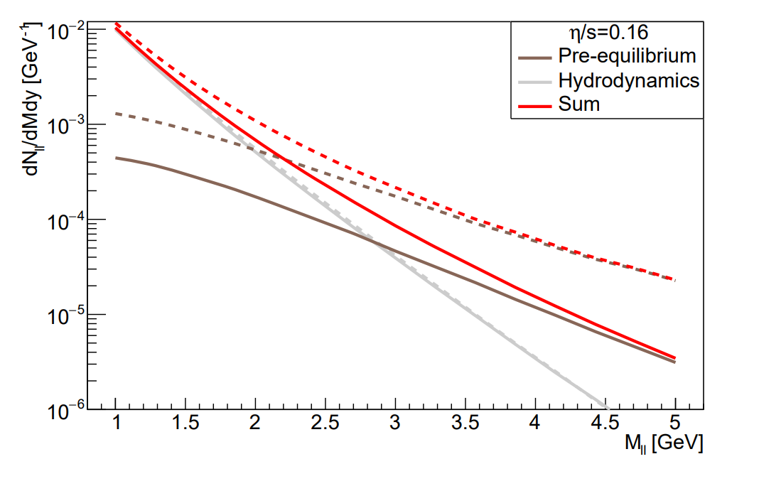
Dileptons

Slide 33
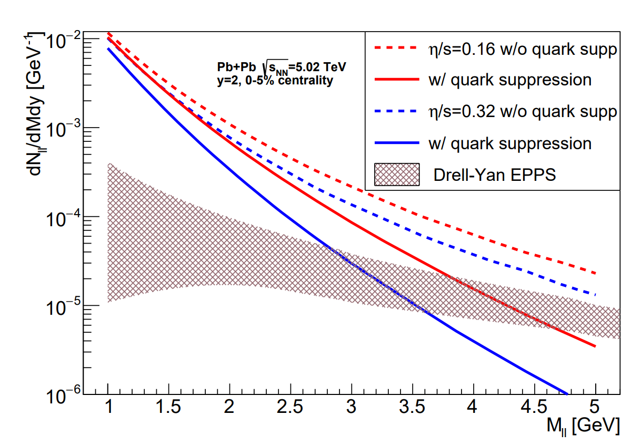

Slide 34
Why do we study charm quarks?

Slide 35
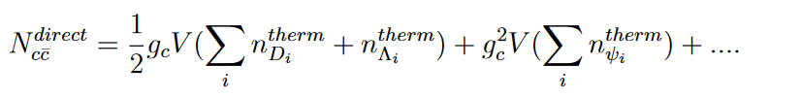
Statistical hadronization model
“We assume that all c¯c pairs are produced in direct, hard collisions, i.e. in line with previous considerations we neglect thermal production.”

Slide 36
Transport model

